Slide 1
Introduction to DBMS
Day 3

Slide 2
General Guideline
© (2021) ABES Engineering College.
This document contains valuable confidential and proprietary information of ABESEC. Such confidential and proprietary information includes, amongst others, proprietary intellectual property which can be legally protected and commercialized. Such information is furnished herein for training purposes only. Except with the express prior written permission of ABESEC, this document and the information contained herein may not be published, disclosed, or used for any other purpose.

Slide 3
Session Plan - Day 3
Database System Architecture
Data Independence & its types
Phases of Database Design
Database Application Architecture

Slide 4
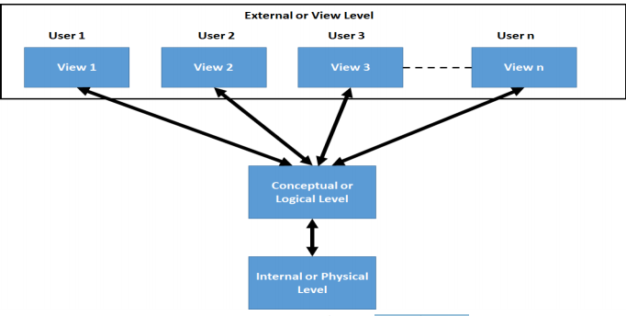
Database System Architecture
Describes User Views
Structure and constraints for the entire database
Actual Physical storage structure and access paths
4

Slide 5
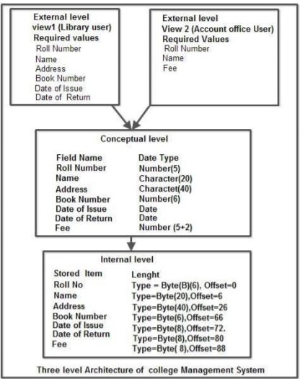
Three level Architecture of College Management System
5

Slide 6
Data Independence
The main objective of the 3-level architecture is to provide Data Independence, which means that upper levels are unaffected by changes at lower levels.
There are two types of data independence:
- Physical Data Independence
- Conceptual Data Independence
6

Slide 7
Types of Data Independence
Physical Data Independence: Any change in the physical location of tables and indexes should not affect the conceptual level or external view of data. This data independence is easy to achieve and implemented by most of the DBMS today.
Conceptual Data Independence: The data at conceptual level schema and external level schema must be independent. This means a change in conceptual schema should not affect external schema. e.g., Adding or deleting attributes of a table should not affect the user's view of the table.
7

Slide 8
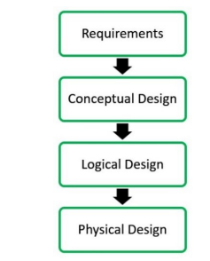
Phases of database design
Database designing for a real-world application starts from capturing the requirements to physical implementation using DBMS
The requirements of the database are captured using the high-level conceptual data model
Logical Design represents data in the form of a relational model
In physical design, data in a relational model is implemented using commercial DBMS like Oracle, DB2
8

Slide 9
Database Application Architecture
A database application is a computer program whose primary purpose is entering and retrieving information from a computerized database.
Database applications allow users to gain access to the data they need. By using a database application, one can enter, update, read and delete data from a database.
Most end-user targeted database applications provide a presentation layer called graphical user interface (GUI) to work with. For example – Customer Relationship Management (CRM) applications, accounting applications, e-commerce applications running on World Wide Web.
There are mainly three types of database application architecture:
Single-tier Architecture
Two-tier Architecture
Three-tier Architecture

Slide 10
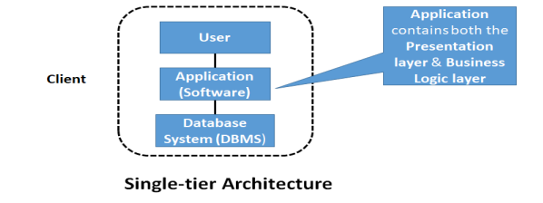
Single-tier Architecture
It is a centralized implementation of the database application.
It is used for the development of the local application, where programmers can directly communicate with the database.

Slide 11
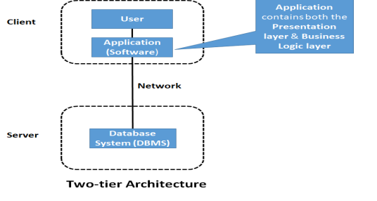
Two-tier Architecture
In a two-tier architecture, the application resides at the client machine, where it invokes database system (DBMS) functionality, over the network, at the server machine through query language statements.
Application program interface standards like ODBC and JDBC are used for interaction between the client and the server.
Example – desktop applications,
games,music players, etc.

Slide 12
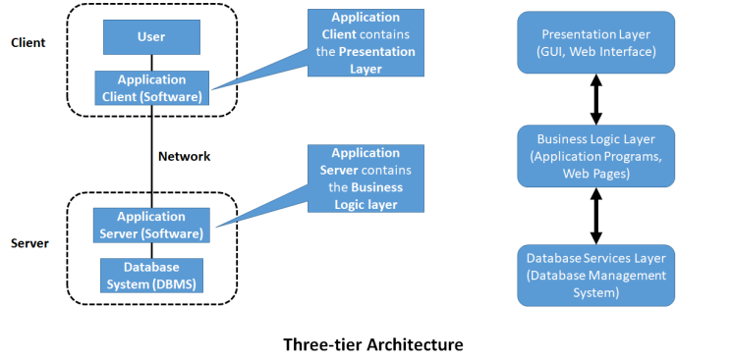
Three-tier Architecture
In a three-tier architecture, the client machine acts as front end and does not contain any direct database calls.
The application server, in turn, communicates with a database system (DBMS) to access data.
Three-tier applications are more appropriate for large applications and for applications that run on World Wide Web.

Slide 13
MCQ’s
1 | Identify the correct statement.
A | Logical level Abstraction: hide details of data types
B | Logical level Abstraction: describes how schema is stored in a data base
C | Logical level Abstraction: describes how a record is stored.
D | Logical level Abstraction: describes accessibility of the database by an individual user.
Explanation | Logical level Abstraction: describes how schema is stored in a data base
Exam Type | Self

Slide 14
MCQ’s
2 | Identify the correct statement.
A | Physical Data Independence is defined as the ability to make changes in the physical level without affecting the higher-level
B | Physical Data Independence is defined as the ability to make changes in Logical level without affecting the highest level.
C | Logical Data Independence defined as the ability to make changes in the physical level without affecting the higher-level
D | All of these
Explanation | Physical Data Independence is defined as the ability to make changes in the physical level without affecting the higher-level
Exam Type | Self

Slide 15
Can you Answer these questions?
Q No 1. Explain DataBase System Architecture?
Q No 2. What is Data Independence?What are its types?
Q No 3. What are different phases of Database Design?
Q No 4. What are types of Database Application Architecture?

Slide 16
Thank You

